Slide 1
Active Directory 102 Common Attack Paths (Getting a foothold)

Slide 2
Whoami?
Name: Daniel Little
Job Role: Senior Penetration Tester at Claranet Cyber Security
Experience: 8 Years Pentesting 2 years Network engineer
Overview: All round pentester cyber security nerd with a passion for sharing knowledge.
Github:- https://github.com/Mr-Whiskerss
Discord:- mr__whiskers
Linked: https://www.linkedin.com/in/daniel-little-b4a171101/

Slide 3
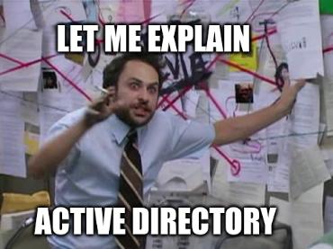
What will be learning today?
Attacking AD!!
Stepping stones what to look for when attacking AD and how to get information.
How to Get a foothold into AD

Slide 4
Disclaimer
I could spend now till 2027 talking about AD Security I sadly do not have that amount of time.
I have 30 mins and a lot to cover so I highly encourage you all to perform your own research on anything you see in today's presentation.
I also apologies for any spelling mistakes found please raise them to me and I will get them fixed.
Also this is not a definite list I have just picked the most common tools and attacks I have used during my time testing.
A copy of this talk can be found on my Github in my Talks Repo same for 101

Slide 5
Quick Recap
AD 101 (Please go watch the video on youtube)
We discussed the following-
Basic concepts of AD how the network is normally put together.
Basic Tools used to attack AD
A slight introduction to attacking AD.
Talk link for video:https://www.youtube.com/watch?v=Ey9sk6PB7gk&t=1399s

Slide 6
Information Gathering within Active directory
Service Targets!!! (The whole of AD right?) SMB- Versions of Windows open shared drives anonymous access? LDAP- is Ldap signing enabled? If not this can give you a list of usernames? (Needs Creds)
Netbios - Gives you machine names can also give you an idea on how usernames are constructed.
FTP- Anon access again any hidden files?

Slide 7
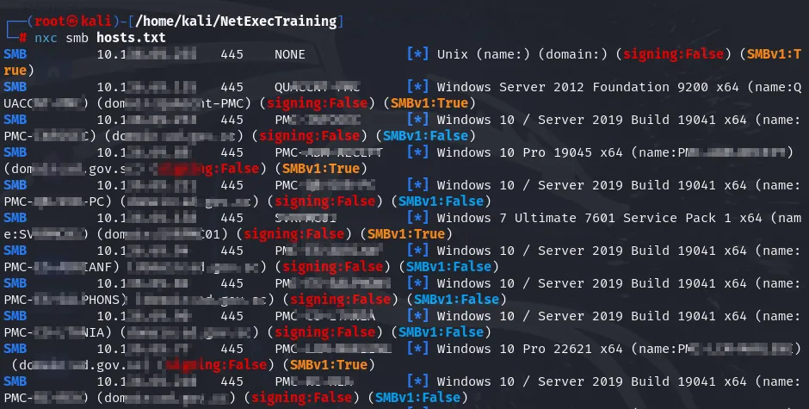
SMB Enumeration (No creds)
Many tools can be used here Nmap Enum4linux but I love NXC for this!

Slide 8
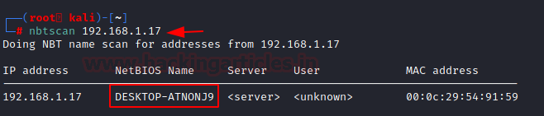
Netbios Enumeration
Information from here is often limited but can give you the name of the system which can be useful

Slide 9
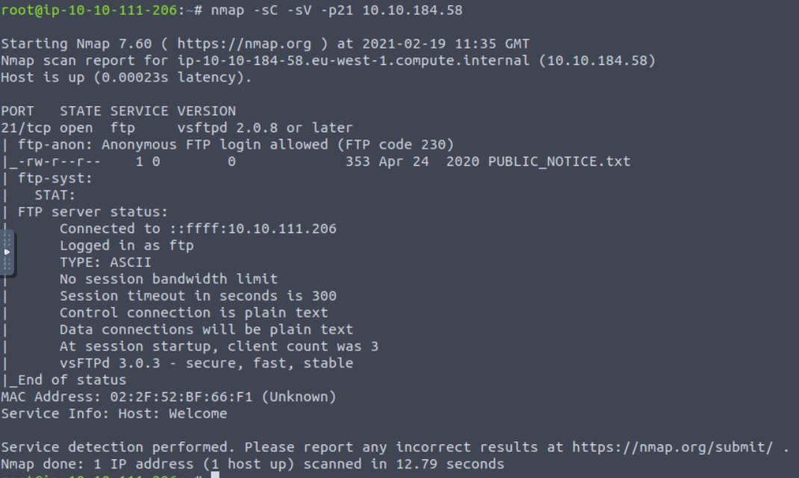
FTP Servers
Sometimes FTP servers will have files linked to AD but are often Linu Hosts. Think Printers or forgotten linux servers.

Slide 10
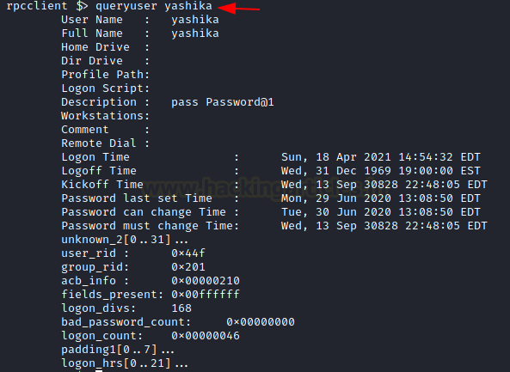
RPC (Remote Procedure Call)
This can be a goal mine for getting usernames from a local system often no longer able to due to updated in recent versions of Windows after Server 2016 and Windows 10
Nmap can be used for this and so can NXC as well as RPC Client.

Slide 11

Getting a foothold!
This is often the most hardest part of AD testing in my view. Once you have some credentials the cards will start to fall and you can get AD. The getting working credentials is the hard part.

Slide 12
LDAP Anonymous Bind
A lot of information on an AD domain can be obtained through LDAP. However most of the time it is not possible due to needing credentials.
Ldapsearch tool can be used here to connect to the LDAP server and enumeration the full list of users if anonymous is enabled.

Slide 13
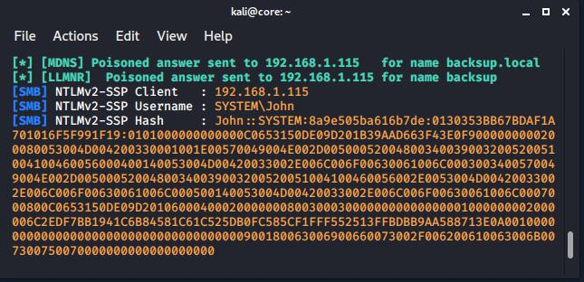
LLMNR Poisoning
My go to way to get a foothold within AD. Often has been my go to way to get credentials. One of the most common attack paths I see in internal testing.

Slide 14
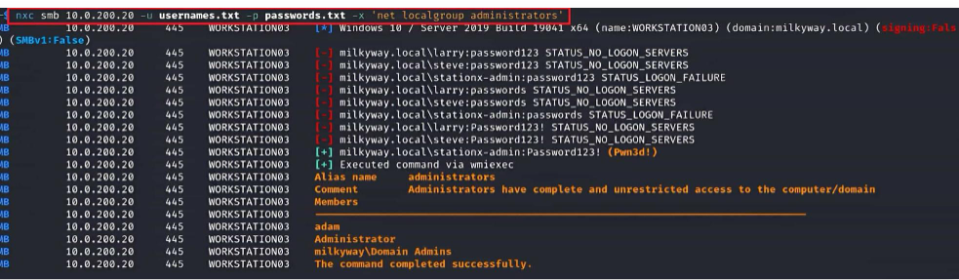
Password spraying
A common yet in my view not so effective way to get a account is to password spray
For this to be best affective I recommend trying to find the password policy so you can create a top 3 common used passwords based around the clients policy
Find usernames on Linkedin even if SE is out of the question Linkedin is a gold mine for information!
v

Slide 15
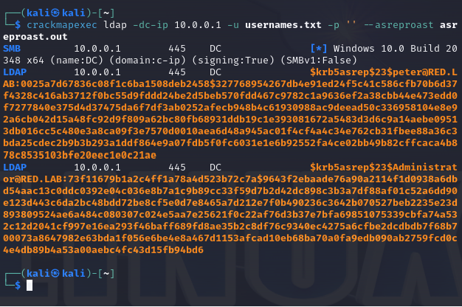
Asrep Roasting
AS-REP Roasting is a technique that enables adversaries to steal the password hashes of user accounts that have Kerberos preauthentication disabled, which they can then attempt to crack offline. This can also be performed once you have your first foothold.
Impacket tool kit and NXC can perform this attack. You do need a list of users that work for this attack not passwords.

Slide 16
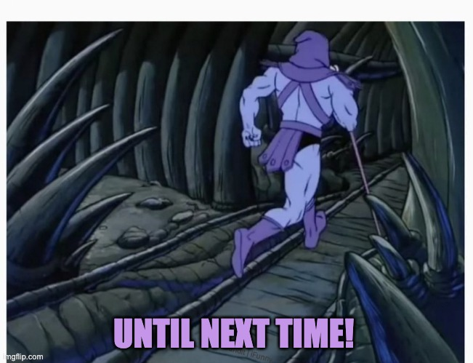
Next talk 103!
As there is so much to AD I want to split these talks and take you all on a ride from foot hold to privilege escalation to compromising AD and beyond ! I hope you join me next time in 104! Escalation of privileges.!

Slide 17
References
The following References were used for this talk.
https://orange-cyberdefense.github.io/ocd-mindmaps/img/mindmap_ad_dark_classic_2025.03.excalidraw.svg

